Slide 1
Critical Perspectives on Cultural Data Analysis
Week 8

Slide 2
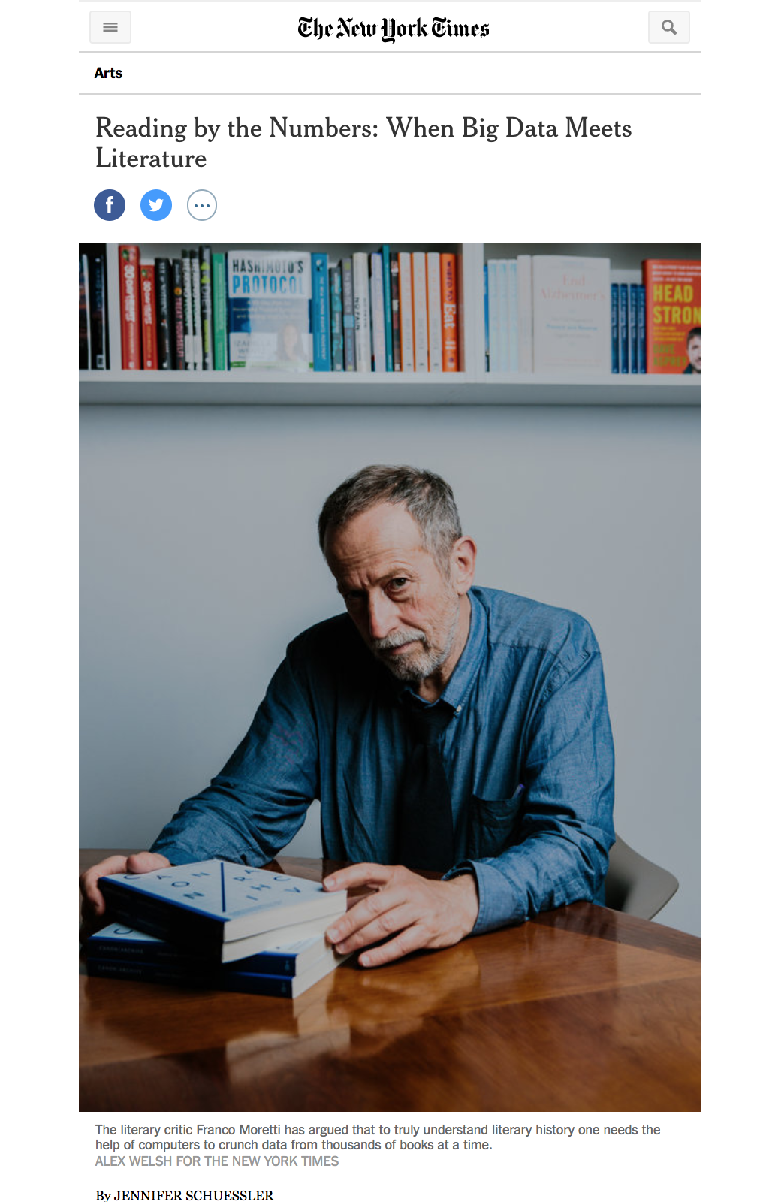
https://mobile.nytimes.com/2017/10/30/arts/franco-moretti-stanford-literary-lab-big-data.html

Slide 3
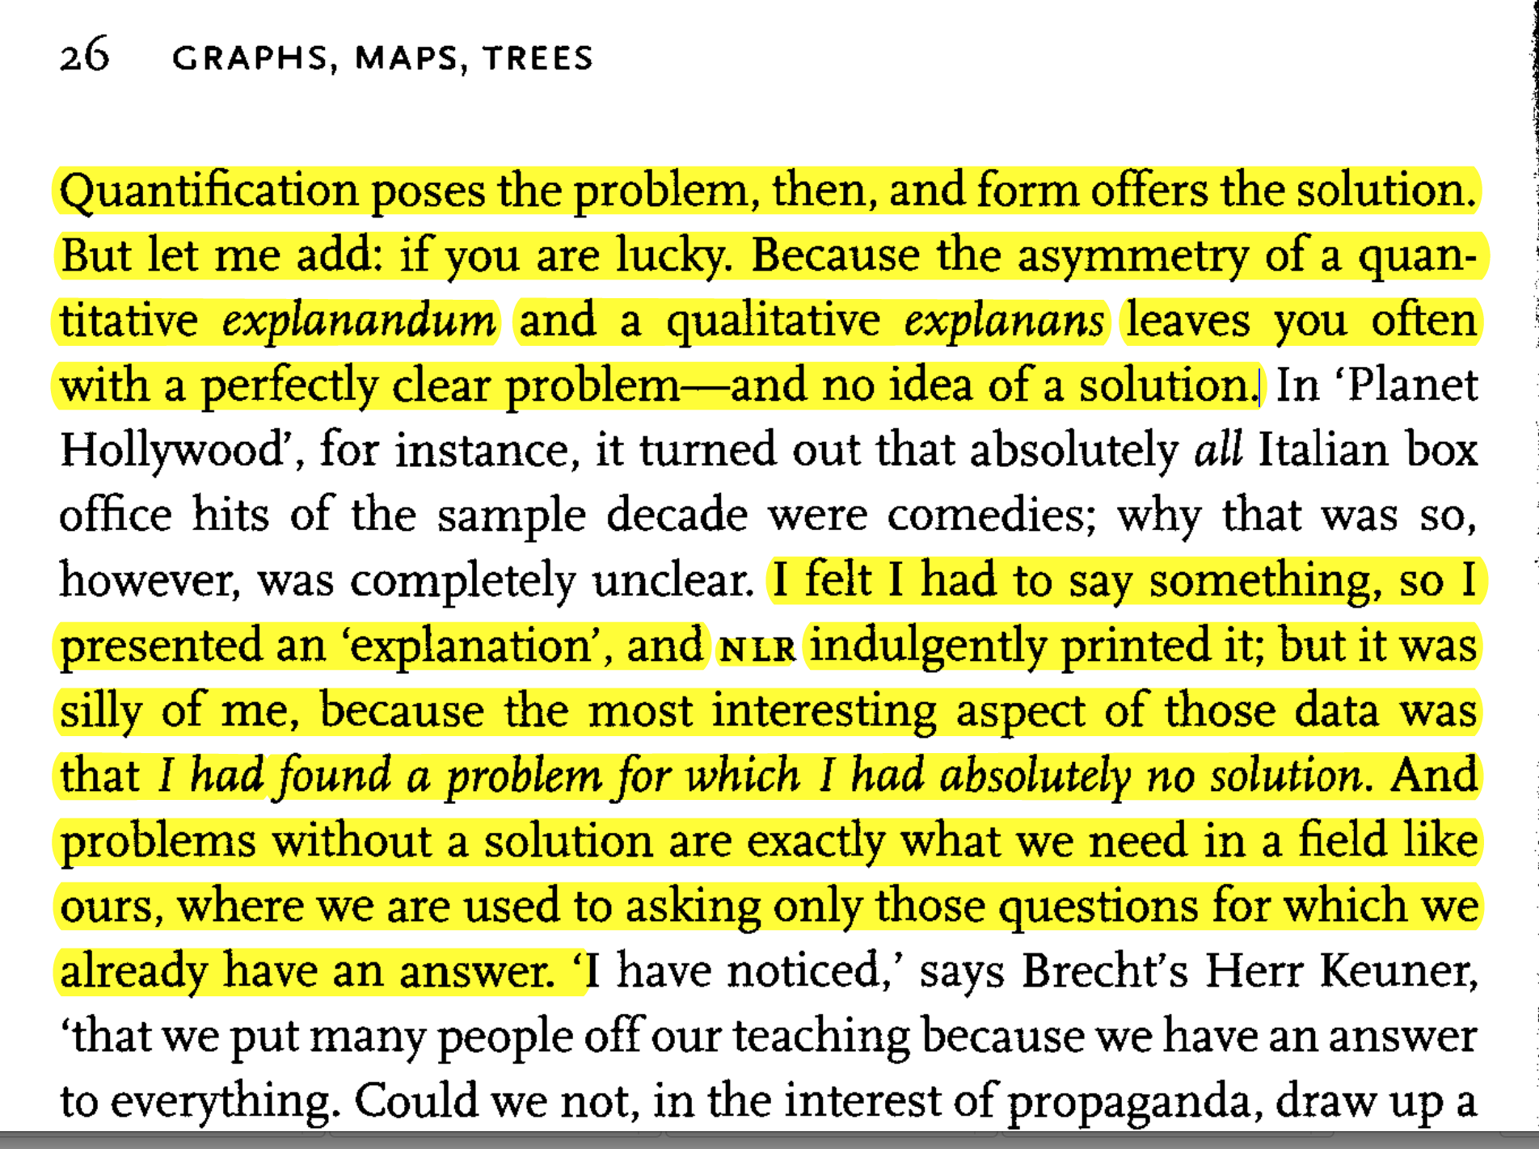
- Moretti, Franco. “Graphs.” In *Graphs, Maps, Trees: Abstract Models for Literary History *, 3–33. London ; New York: Verso, 2007.

Slide 4
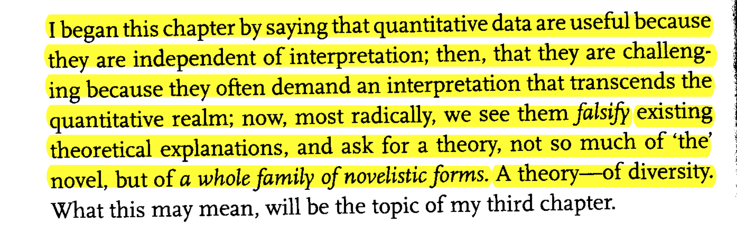

Slide 5
Reasons to do Stats and Viz
Statistics: a systematic, mathematically principled methodology for analyzing quantitative data
Visualization: a designed way of representing data to allow a viewer to better explore and understand it
Montfort, Nick. “Statistics and Visualization.” In *Exploratory Programming for the Arts
and Humanities*, 215–40. Cambridge, MA: The MIT Press, 2016.

Slide 6
Reasons to do Stats and Viz
The researcher/writer: has a rhetorical purpose and wants to persuade others by supporting his point.
Has a conclusion
The researcher/explorer: is trying to identify unexpected trends and correlations in the data
Has a hypothesis
Montfort, Nick. “Statistics and Visualization.” In *Exploratory Programming for the Arts
and Humanities*, 215–40. Cambridge, MA: The MIT Press, 2016.

Slide 7
Distributions
Distribution: the set of possible outcomes weighted by their probability
Mean: the average
Median: the middle point of a sorted list of numbers (if no middle, take the average of the middle 2).
Mode: the most common value in a distribution
Variance: how data are distributed around the center
Standard deviation: the square root of the variance
Montfort, Nick. “Statistics and Visualization.” In *Exploratory Programming for the Arts
and Humanities*, 215–40. Cambridge, MA: The MIT Press, 2016.

Slide 8
These three averages
Are different methods that should fit into a methodology and be used systematically
Mean: very sensitive to outliers
Median: not sensitive to outliers (which could be errors)
Mode: useful with discrete data, not sensitive to outliers (which could be errors), not sensible for a continuous measurement
Montfort, Nick. “Statistics and Visualization.” In *Exploratory Programming for the Arts
and Humanities*, 215–40. Cambridge, MA: The MIT Press, 2016.

Slide 9
Stats and Probability and Smoothing
Statistics works on samples of data
Probabilistic processes typically generate this data -- The data we have, like all data, is an abstraction involving choices, not a perfect image of reality.
Smoothing: In statistics and image processing, to smooth a data set is to create an approximating function that attempts to capture important patterns in the data, while leaving out noise or other fine-scale structures/rapid phenomena.
http://www.matthewjockers.net/2015/03/24/ringing_endorsement/
Montfort, Nick. “Statistics and Visualization.” In *Exploratory Programming for the Arts
and Humanities*, 215–40. Cambridge, MA: The MIT Press, 2016.

Slide 10
Stats and Probability
Statistics works on samples of data
Probabilistic processes typically generate this data -- The data we have, like all data, is an abstraction involving choices, not a perfect image of reality.
Montfort, Nick. “Statistics and Visualization.” In *Exploratory Programming for the Arts
and Humanities*, 215–40. Cambridge, MA: The MIT Press, 2016.

Slide 11
Abstractions and collections as data
On Project Gutenberg texts:
“ . . . in using these books as data, it’s important to understand the abstractions that these e-texts are, and what can and cannot be learned from them. This may mean choosing the HTML version of the e-text, if italicization is important, or choosing images of pages, if visual qualities of the book are important” (232)
Montfort, Nick. “Statistics and Visualization.” In *Exploratory Programming for the Arts
and Humanities*, 215–40. Cambridge, MA: The MIT Press, 2016.

Slide 12
1. More Data Isn’t Always Better:
If the data is not normal, more data will not reduce your margin of error in the expected manner.
Is the cost of a false positive the same as that of a false negative? The cost of failing to detect a life-threatening illness may be greater, for example, than the cost of incorrect diagnosis.
2. More Data Isn’t Always Easy: Data doesn’t necessarily scale.
3. Data Alone Doesn’t Explain. People explain. Creating stories about data is only human: it’s the ability to revise consistently that makes a story sound.
Krumme, Coco. “What Data Doesn’t Do.” In Beautiful Data: The Stories behind Elegant Data Solutions, edited by Toby Segaran and Jeff Hammerbacher, 1st ed. Beijing ; Sebastopol, CA: O’Reilly, 2009.

Slide 13
4. Data Isn’t Good for a Single Answer. Descriptive statistics can hide detail. Variation is the hard reality, not a set of imperfect measures for a central tendency. Means and medians are the abstractions. -- Stephen Jay Gould
5. Data Doesn’t Predict
6. Probability Isn’t Intuitive When using data to answer a question, we don’t know what evidence to exclude and how to weight what we include -- the “base rate fallacy.”
Krumme, Coco. “What Data Doesn’t Do.” In Beautiful Data: The Stories behind Elegant Data Solutions, edited by Toby Segaran and Jeff Hammerbacher, 1st ed. Beijing ; Sebastopol, CA: O’Reilly, 2009.

Slide 14
7. Probabilities Aren’t Intuitive individuals rely on past observations to estimate probabilities.
9. Data Doesn’t Stand Alone. Our models can be refined in part by attempting to quantify subjective features.
10. Data Isn’t Free from the Eye of the Beholder
Krumme, Coco. “What Data Doesn’t Do.” In Beautiful Data: The Stories behind Elegant Data Solutions, edited by Toby Segaran and Jeff Hammerbacher, 1st ed. Beijing ; Sebastopol, CA: O’Reilly, 2009.

Slide 15
Scientific Viz vs. Infovis
SV uses numerical data; IV uses non-numeric data such as text and networks of relations
SV uses 3D; IV uses 2D
SV from Science; IV from Design
IV uses arbitrary spatial arrangements of data
SV uses meaningful spatial arrangements such as a brain, a coastline, a galaxy, etc.
Manovich, L. ‘What is visualization?’ Visual Studies, 26.1 (2011): 36-49.

Slide 16
InfoViz vs. Design Viz
ID starts with data that has a clear structure and expresses it visually
IV is to discover the the structure of a (typically) large data set
ID works with information
IV works with data
Partially overlapping but ultimately different in terms of their functions
Manovich, L. ‘What is visualization?’ Visual Studies, 26.1 (2011): 36-49.

Slide 17
So, what is Information Visualization (infovis)?
Mapping between discrete data and a visual representation
Methods rely on two principles:
Reduction
graphical primitives such as points, straight lines, curves, and geometric shapes stand in for objects and relations between them
Use of spatial variables
position, size, shape, movement
Manovich, L. ‘What is visualization?’ Visual Studies, 26.1 (2011): 36-49.

Slide 18
Algorithms and Smoothing
Smoothing: In statistics and image processing, to smooth a data set is to create an approximating function that attempts to capture important patterns in the data, while leaving out noise or other fine-scale structures/rapid phenomena.
http://www.matthewjockers.net/2015/03/24/ringing_endorsement/
Put simply: digital humanists do not need to understand algorithms at all. They do need, however, to understand the transformations that algorithms attempt to bring about. If we do so, our practice will be more effective and more likely to be truly original.
Schmidt, B. "Do Digital Humanists Need to Understand Algorithms?
<http://dhdebates.gc.cuny.edu/debates/text/99>

Slide 19
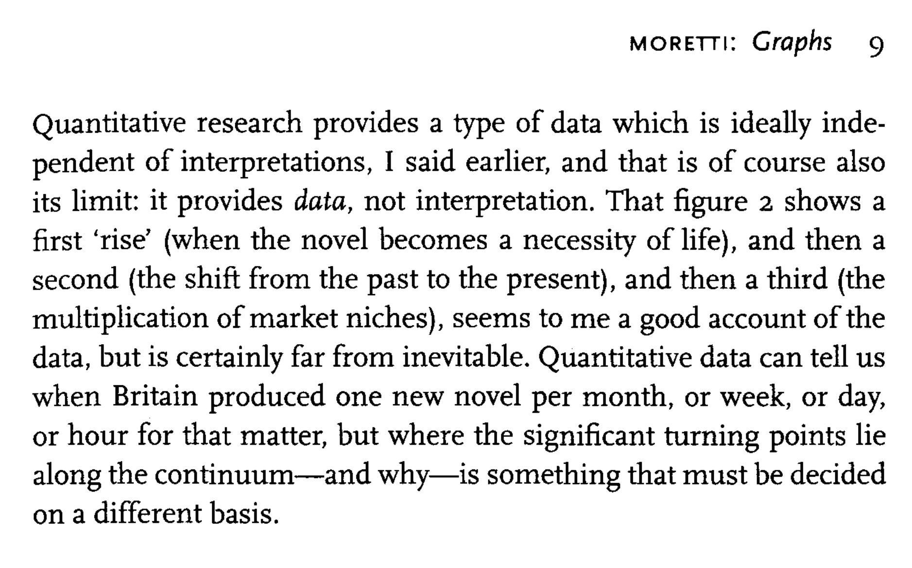

Slide 20
